Slide 1
Welcome to bharatvarsh
-Noble india
-2022

Slide 2
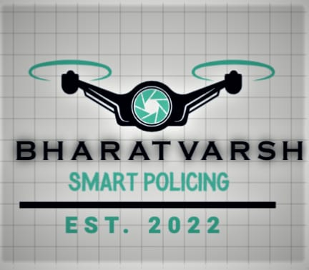
Our main purpose to upgrade the drone system for our defence and surveys,
And also solving the problems which we are facing in modern world.
Drones are basically many types, on which basis they are performs their task and the work under which they are working and for working,
They are really prove helper machine in the pandemic timing where the people are not able to move out from their houses but drones carries the medicines and other important things which peoples and services are needed.

Slide 3
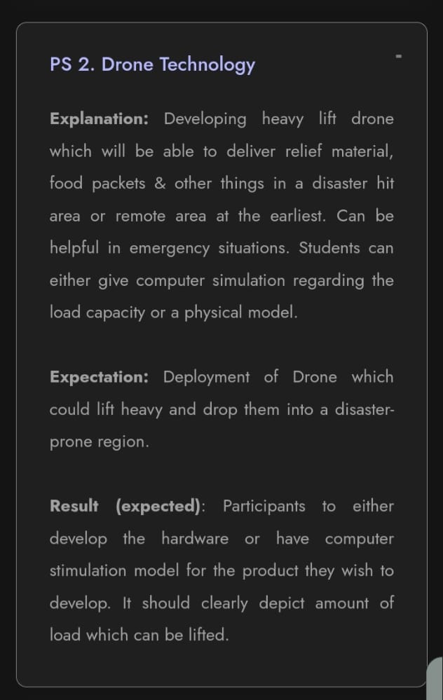
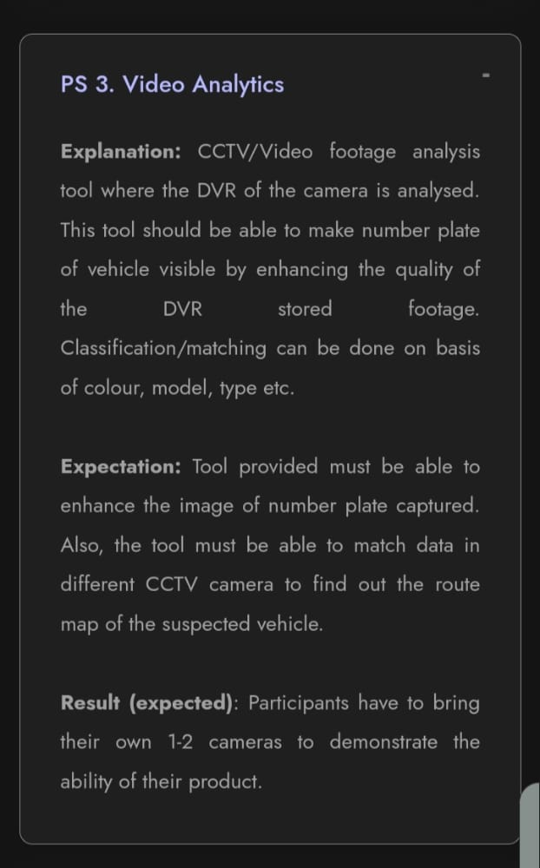
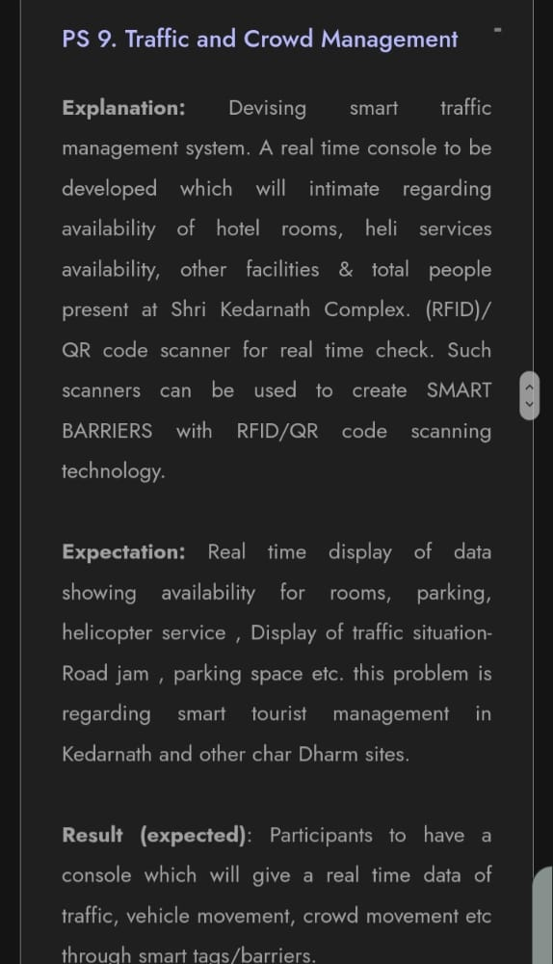
Problem statements……..

Slide 4
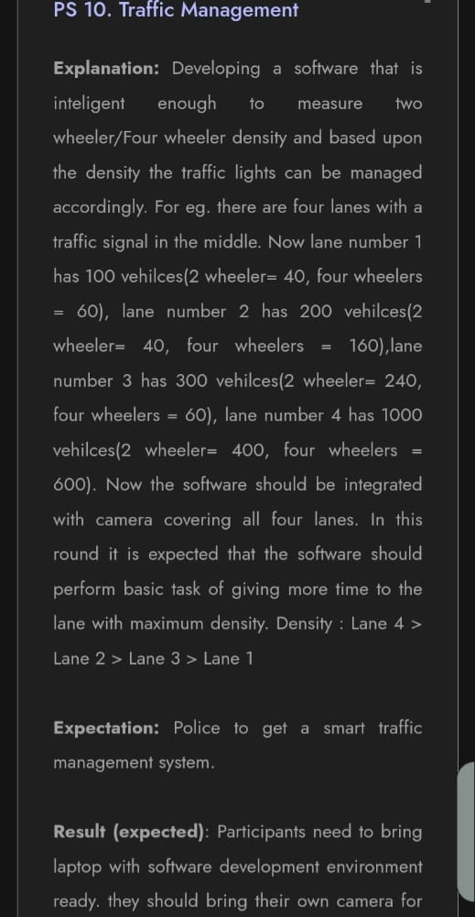
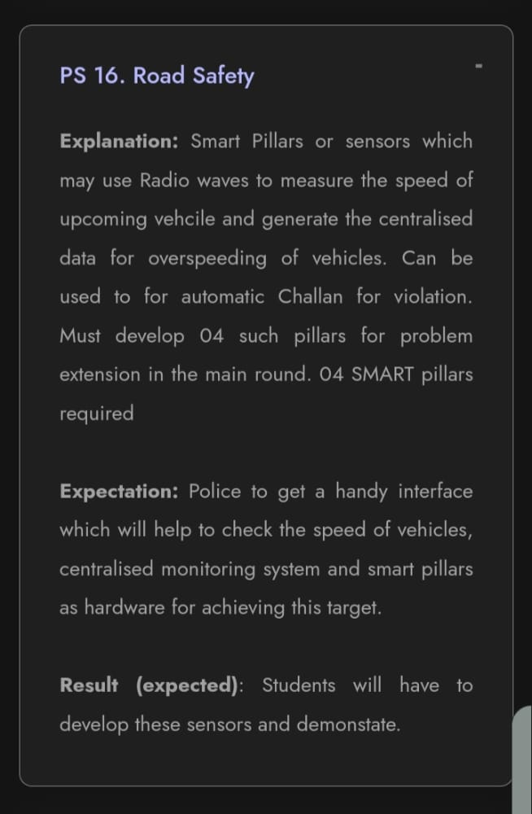
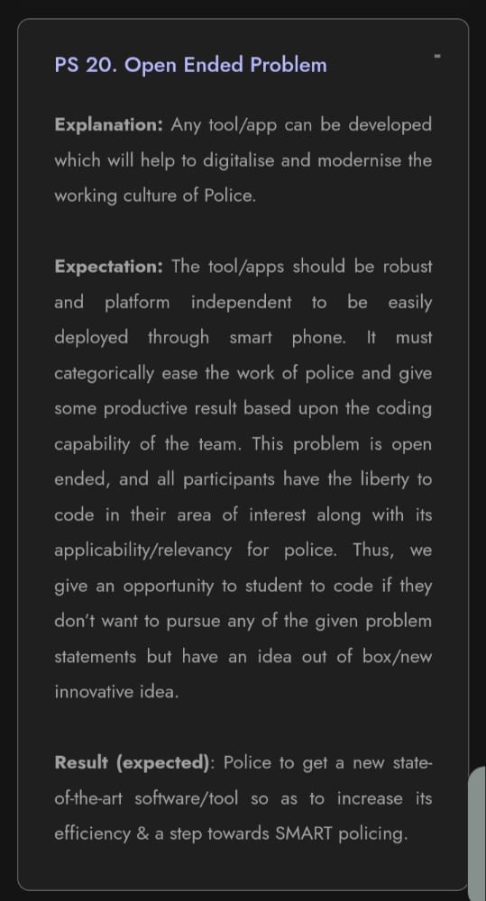
Problem statements…../

Slide 5
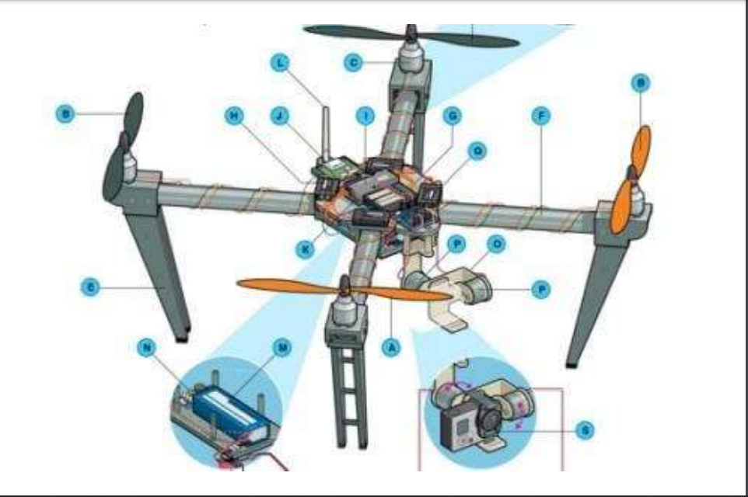
This is quadcopter and basically is called drone……

Slide 6
Main Objective For The drones and problem statement
First thing is our drone is lift heavy weight and also with specific speed that the thing is not going to damage.
A.I based drones, which perform in highly sensitive Areas to detect the unwanted data
Second thing is the quality of camera is best that data which is captured during the time of flying the drone.
Object detection.
Image and video quality is best.
Body must be strong for perform the challenges of monsoon and heavy winds.
The body is covered by light exterior metal(nylon or carbon made)

Slide 7
There are many parts which makes drone more reliable and perfect to fly and makes the landing perfect.
Brushless motors: more efficient and powerful than other motors.
Landing gear: which makes the landing perfect.
Flight controller: Consist of gps , and auto-piolet.
ESC: offer high power, high frequency, high resolution 3- phase AC power to the motors.
GPS: navigation system to detect in which area drone is on work.
Propeller: 3-blade propellers are better than 2-blade propellers for drones when it comes to the smoothness of flights and creating a greater amount of lift. 2-blade propellers.
Antenna: Depending on your receiver, it may be a loose wire whip or helical “rubber ducky” type.
Camera and Sensors: Real-time streaming is possible on the latest drones such as the DJI Mavic Pro, the new Phantom 4 Pro, With the wrong camera on your drone, you will never be able to take professional videos or photos.
Battery: Lithium polymer (LiPo) batteries offer the best combination of energy density, power density, and lifetime on the market.

Slide 8
•ACCELEROMETERS : Used to measure acceleration force.
•INERTIA MEASUREMENT UNITS : Measures and report a body’s specific force, angular rate, and sometimes orientation of the body.
•TILT SENSORS : Enables the easy detection of orientation or inclination.
•PARKING SENSOR : Designed to alert the driver of obstacles while parking
•ULTRASONIC SENSORS
•CURRENT SENSOR
•TEMPERATURE SENSOR
For Software design we used Arduino.

Slide 9
1st problem solved: Deployment of drone which is able to lift heavy and drop into a disaster prone region.
2nd problem solution: Our Drone must be able to enhance the image of number plate captured.
Also, the tool is able to match data in different Cctv camera to find out the route map of the suspected vehicle.
3rd problem solution: Real time display of data showing availability for rooms, parking, helicopters service, display of traffic situation road jam, parking space etc. This problem is regarding smart tourist management in Kedarnath and other Chardham sites.
4th problem solution: It provide the tool by which police can get a smart traffic management system.
5th problem solution: It can help Police to get a handy interface which will help to check the speed of vehicles, centralised monitoring system.
6th problem solution: ??

